Slide 1

CA Community College Mentoring Program
MICHELE SIQUEIROS
Notes:
Introduction to presentation

Slide 2


OUR WORK
COLLEGE ACCESS
EQUITY
AFFORDABILITY
COMPLETION
#LeftOut
@CollegeOpp

Slide 3

OUR
LATEST
RESEARCH
#LeftOut

Slide 4
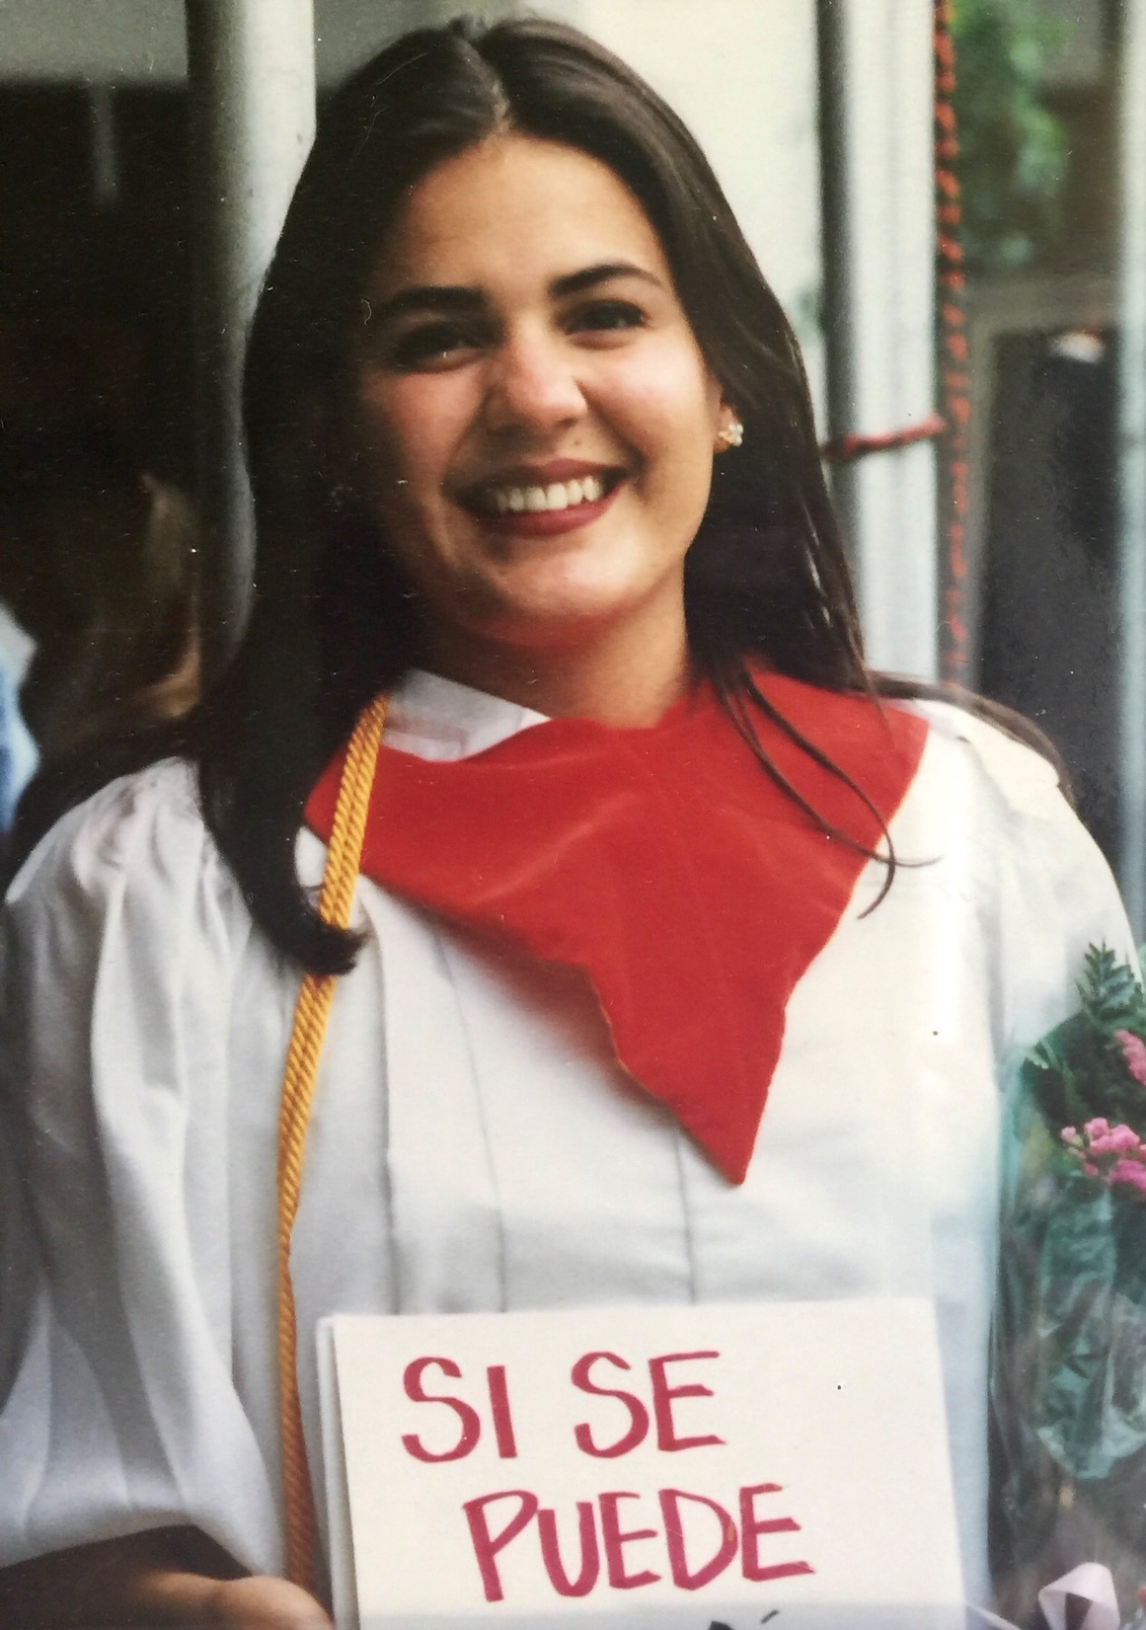
#ISawMyself
@CollegeOpp

Slide 5

“See their charms and challenges without the filters of ‘urban,’ ‘minority’ or ‘at risk.’”
Notes:
In an essay on the importance of Black teachers teaching Black students, the remarks of a 9th grade teacher’s (David Jackson) experiences in the classroom are easily transferred to the college environment. Acknowledging that the amount of melanin in his skin does not grant him superpowers, he nonetheless concludes that having a shared racial identity with his students allows him to “see their charms and challenges without the filters of ‘urban,’ ‘minority’ or ‘at risk.’”

Slide 6


Having a teacher, professor or mentor that resembled me was essential to feeling that I belonged and helping me envision my future. Had I not had women of color in these roles, I may have not been bold enough to see myself pursing an advanced degree.
-Theresa Jean Ambo, UC President’s Scholar, UC San Diego
#LeftOut
@CollegeOpp

Slide 7
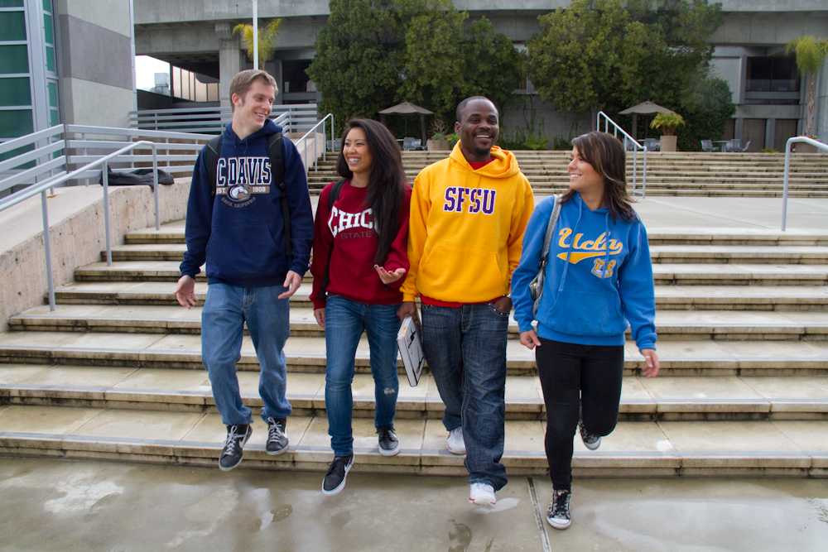
Does Our College Leadership Look Like The Students They Serve?
#LeftOut
@CollegeOpp

Slide 8
54% of California Students are Women
Male
Female

Slide 9
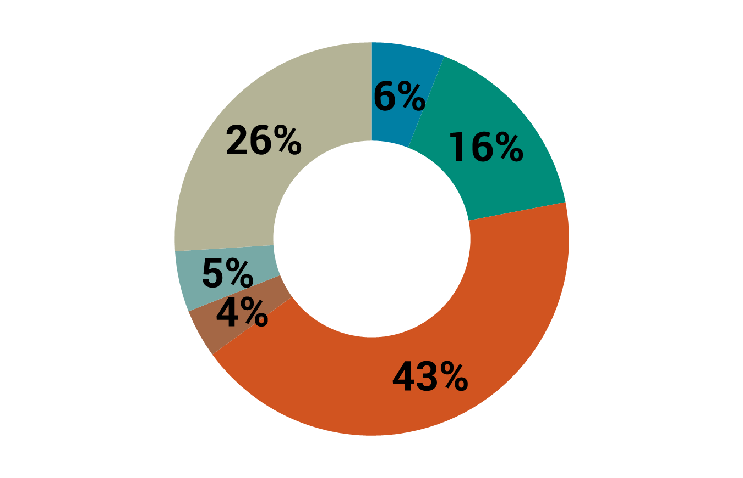

Latinx are the Largest Racial Demographic Attending College in the California
White
AANHPI
African American
Latinx
Other
Unknown
Notes:
This includes public and private colleges and universities

Slide 10


For Every 1 Latinx Tenured Faculty Member
there are 282 Latinx students
For Whites, the ratio is 1 to 32
#LeftOut

Slide 11
University of California
Students vs. Faculty & Senior Leadership Demographics
White
AANHPI
African American
Latinx
Other
Unknown

Slide 12
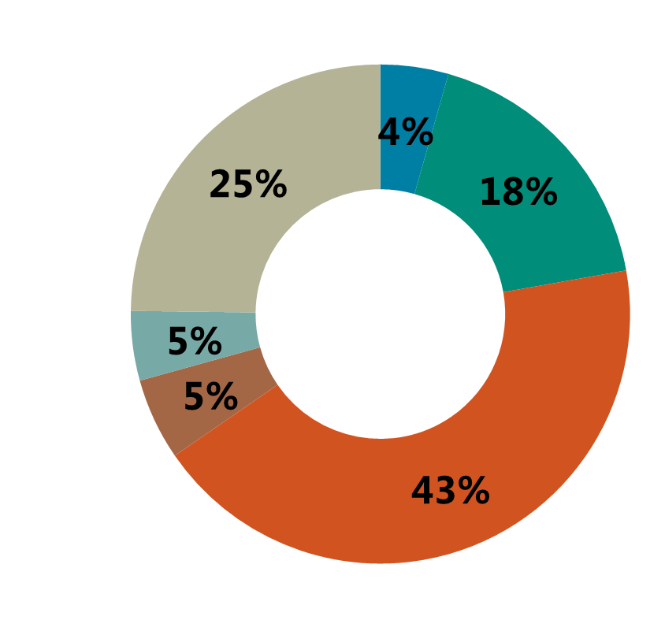
California State University
Students vs. Faculty & Senior Leadership Demographics
White
AANHPI
African American
Latinx
Other
Unknown

Slide 13
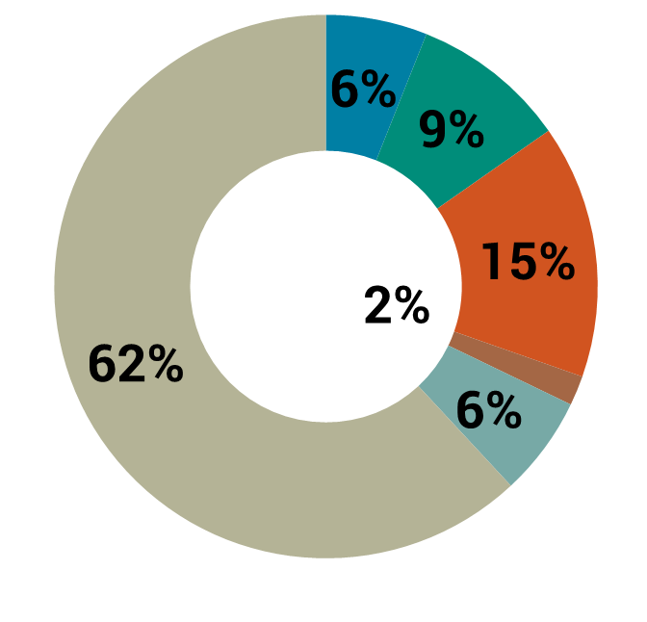
California Community College
Students vs. Faculty & Senior Leadership Demographics
White
AANHPI
African American
Latinx
Other
Unknown

Slide 14
California Community College Campus Demographics
ENROLLMENT
TENURED FACULTY
NON-TENURED FACULTY
White
AANHPI
African American
Latinx
Other
Unknown

Slide 15
California Community College Campus Demographics
ENROLLMENT
CAMPUS ACADEMIC SENATES
SENIOR LEADERSHIP
White
AANHPI
African American
Latinx
Other
Unknown

Slide 16
California Community College
System Demographics
White
AANHPI
African American
Latinx
Other
Unknown

Slide 17

BRIGHT SPOTS
#LeftOut
@CollegeOpp
Notes:
There are bright spots

Slide 18
Between 2012-2016, the CSU and the
UC awarded a combined 150,000 Master’s
and Doctorate degrees
Of these, more than 64,000 (43%) were awarded to african american, AANHPI, latinx and multiethnic graduates
Notes:
Demystifying the myth – Is it really true that there aren’t many qualified Latinx, African Americans, AANHPI’s to fill these top leadership roles?

Slide 19
Latinx earning Advanced Degrees
Between 2012-2016, more than 20,000 (14%) masters and doctorate degrees were awarded to latinx students
During this time, latinx students earning advanced degrees increased from
12.5% to 15% of all advanced degrees earned
Notes:
Demystifying the myth – Is it really true that there aren’t many qualified Latinx, African Americans, AANHPI’s to fill these top leadership roles?

Slide 20

What Can You Do?
#LeftOut
@CollegeOpp
Notes:
Michele, while all of our recommendations are different, there is some overlap with some of them. I suggest you focus on two main themes here:
On the annual collection of data, you could emphasize the following recommendations:
The UC, CSU and California Community Colleges should annually collect data, disaggregated by race, ethnicity, and gender, for campus leadership and academic senate positions (you might want to talk about the difficulty in getting the data for our report and how we were denied access to a lot of the data)
The UC, CSU and California Community Colleges should be submitting a bi-annual analysis of leadership, faculty and academic senate diversity by race, ethnicity and gender that includes defined goals for improving inclusivity
2. On the role of college Presidents/Chancellors in hiring, you could emphasize the following recommendations:
College leaders should, first and foremost, require diverse applicant pools and they should have the courage and leadership to start searches all over again if the applicant pool did not result in an adequate number of competitive candidates from diverse backgrounds:
College Presidents and senior leadership need to provide clear, unambiguous guidance to hiring committees about Proposition 209 compliance while ensuring an understanding for how to identify and recruit diverse applicants;
Once colleges are successful in bringing on diverse leaders to their campuses, college Presidents and senior leadership need to develop clear pathways to leadership and invest in leadership development opportunities to create a pipeline of staff from diverse groups to enter leadership positions

Slide 21

Read Our Next Steps Toolkit
Notes:
Michele, while all of our recommendations are different, there is some overlap with some of them. I suggest you focus on two main themes here:
On the annual collection of data, you could emphasize the following recommendations:
The UC, CSU and California Community Colleges should annually collect data, disaggregated by race, ethnicity, and gender, for campus leadership and academic senate positions (you might want to talk about the difficulty in getting the data for our report and how we were denied access to a lot of the data)
The UC, CSU and California Community Colleges should be submitting a bi-annual analysis of leadership, faculty and academic senate diversity by race, ethnicity and gender that includes defined goals for improving inclusivity
2. On the role of college Presidents/Chancellors in hiring, you could emphasize the following recommendations:
College leaders should, first and foremost, require diverse applicant pools and they should have the courage and leadership to start searches all over again if the applicant pool did not result in an adequate number of competitive candidates from diverse backgrounds:
College Presidents and senior leadership need to provide clear, unambiguous guidance to hiring committees about Proposition 209 compliance while ensuring an understanding for how to identify and recruit diverse applicants;
Once colleges are successful in bringing on diverse leaders to their campuses, college Presidents and senior leadership need to develop clear pathways to leadership and invest in leadership development opportunities to create a pipeline of staff from diverse groups to enter leadership positions

Slide 22
1.
Form a campus committee to assess the state of racial/ethic and gender equity in campus leadership
2.
Collect disaggregated data showing racial/ethnic and gender representation and convene the committee to review it
3.
Inquire into institutional process that lead to inequitable racial/ethnic representation among campus leadership
Notes:
Michele, while all of our recommendations are different, there is some overlap with some of them. I suggest you focus on two main themes here:
On the annual collection of data, you could emphasize the following recommendations:
The UC, CSU and California Community Colleges should annually collect data, disaggregated by race, ethnicity, and gender, for campus leadership and academic senate positions (you might want to talk about the difficulty in getting the data for our report and how we were denied access to a lot of the data)
The UC, CSU and California Community Colleges should be submitting a bi-annual analysis of leadership, faculty and academic senate diversity by race, ethnicity and gender that includes defined goals for improving inclusivity
2. On the role of college Presidents/Chancellors in hiring, you could emphasize the following recommendations:
College leaders should, first and foremost, require diverse applicant pools and they should have the courage and leadership to start searches all over again if the applicant pool did not result in an adequate number of competitive candidates from diverse backgrounds:
College Presidents and senior leadership need to provide clear, unambiguous guidance to hiring committees about Proposition 209 compliance while ensuring an understanding for how to identify and recruit diverse applicants;
Once colleges are successful in bringing on diverse leaders to their campuses, college Presidents and senior leadership need to develop clear pathways to leadership and invest in leadership development opportunities to create a pipeline of staff from diverse groups to enter leadership positions

Slide 23
Leadership Pathway Map
Ask these questions after each step
Step 1
Step 2
Step 3
What factors prepared you to succeed at this stage?
How did your racial, ethnic, and/or gender identity impact your success at this stage?
What factors prepared you to succeed at this stage?
How did your racial, ethnic, and/or gender identity impact your success at this stage?
What factors prepared you to succeed at this stage?
How did your racial, ethnic, and/or gender identity impact your success at this stage?

Slide 24
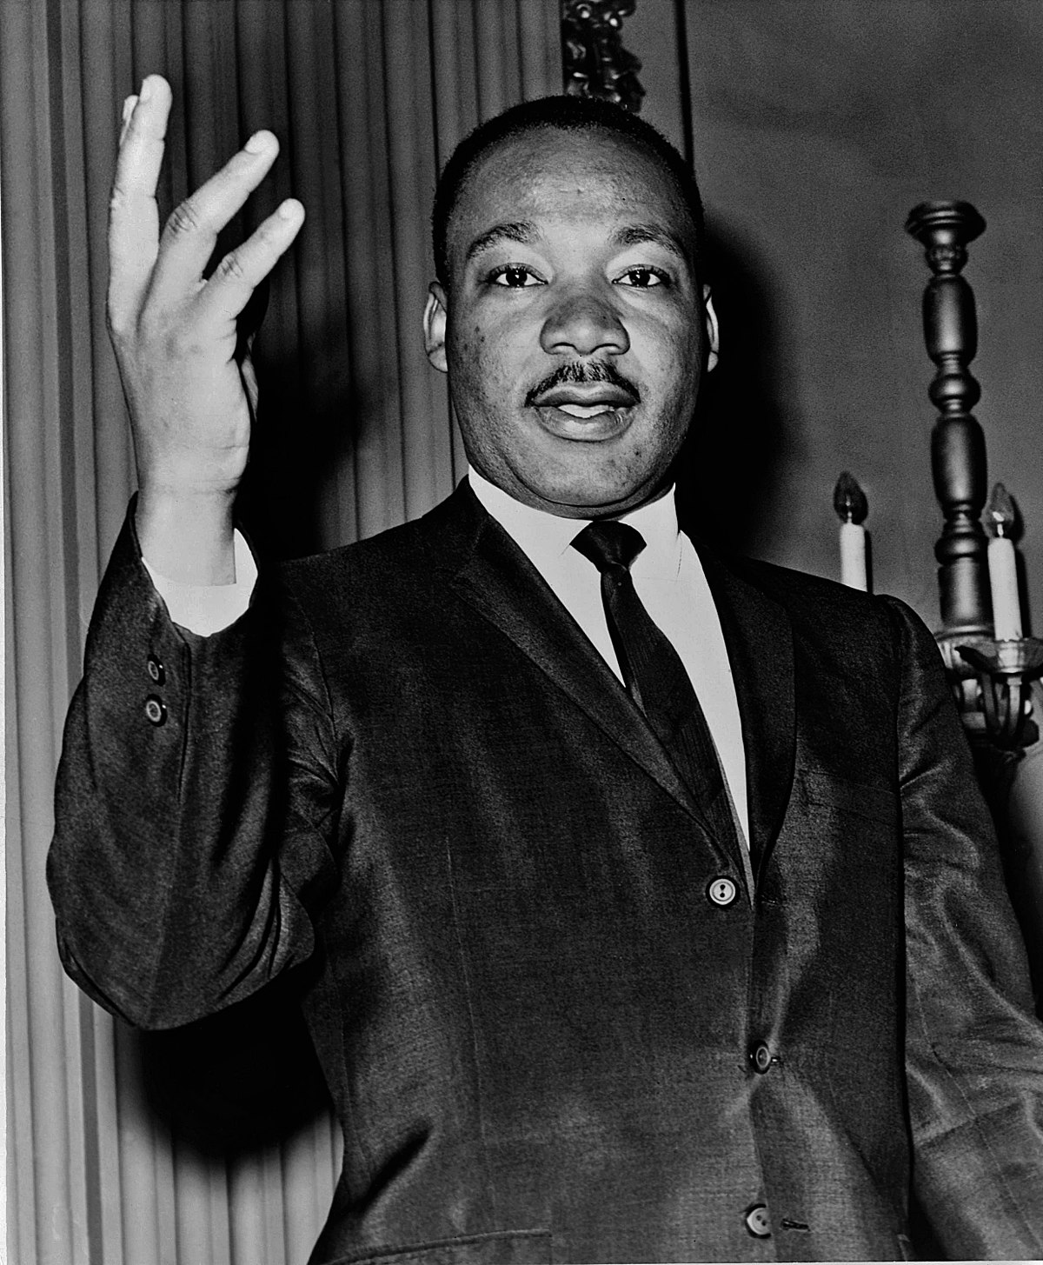
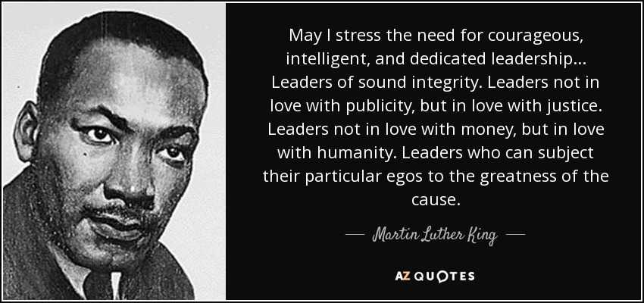
COURAGEOUS LEADERSHIP
Notes:
College leaders should, first and foremost, require diverse applicant pools and they should have the courage and leadership to start searches all over again if the applicant pool did not result in an adequate number of competitive candidates from diverse backgrounds
College Presidents and senior leadership need to provide clear, unambiguous guidance to hiring committees about Proposition 209 compliance while ensuring an understanding for how to identify and recruit diverse applicants;
Once colleges are successful in bringing on diverse leaders to their campuses, college Presidents and senior leadership need to develop clear pathways to leadership and invest in leadership development opportunities to create a pipeline of staff from diverse groups to enter leadership positions

Slide 25

Many believe diversity is an ideal, yet not achieving it is acceptable We need more than an “intellectual commitment” to diversity WE NEED DIVERSITY-RELATED ACTION
#LeftOut
@CollegeOpp

Slide 26




Los Angeles Office:
1149 S. Hill Street, Suite 925 Los Angeles, CA 90015 213-744-9434
www.collegecampaign.org
@CollegeOpp @MSCollegeOpp
Sacramento Office: 1512 14th Street Sacramento, CA 95814 916-443-1681
facebook.com/collegecampaign
@CollegeOpp

