Slide 1



This webinar is being recorded and will be available on www.cccolegas.org
and the Chancellor’s Office Vision Resource Center.
LATINX STUDENT SUCCESS
WEBINAR SERIES
Thank you for joining us, we will begin shortly.
Click the tab to read live captions.
Click this tab to enter questions for the
presenters, and read their responses.
Notes:
This slide will be showing as people join the webinar
Typically the moderator will allow 30 seconds or so to let folks “join” the webinar.
You could say something along the lines of “Thank you for joining us today we will wait a minute or so to begin to allow others to join”

Slide 2
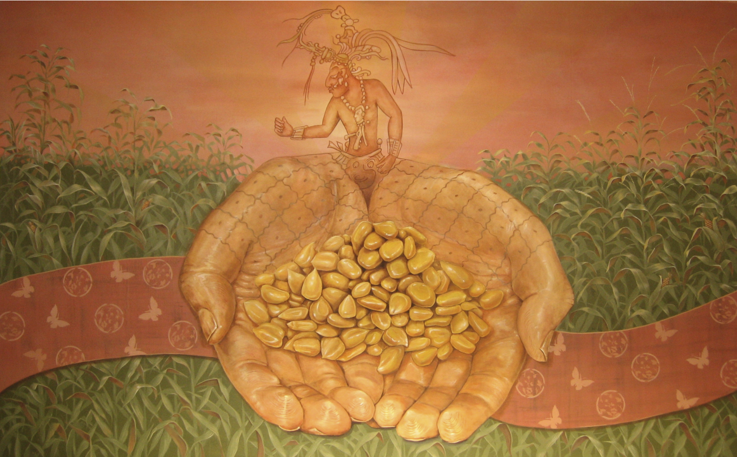


LATINX STUDENT SUCCESS WEBINAR SERIES
Thurs. October 1, 2020
PRESENTS
LATINX WORKFORCE:
COMPLETING THE PROMISE
Artwork: “Corazon de la Comunidad” (East View), Joaquin Alejandro Newman, Carmen Flores Community Center, Oakland, CA, Sponsor: The City of Oakland’s Cultural Arts and Marketing Dep., 2007, Acrylic on Canvas, 8 x 12.
Notes:
Moderator- 2 min
Short self-intro
Welcome to webinar, thank you for joining us
This will be recorded,
Recording and ppt will be posted later on our webpage: www.cccolegas.org and CO VRC (instructions to access will be provided at end of the presentation)

Slide 3
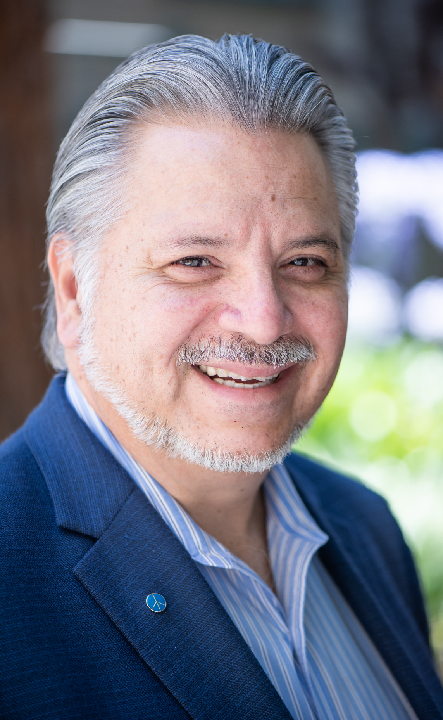
MISSION
COLEGAS is comprised of Latinx professionals who, through intentional advocacy and coalition building, lead and influence transformative systemic change within the California Community College system. We seek to foster and empower Latinx professionals through mentorship, networking, and professional development to ascend and assume leadership roles at the highest influential levels to eradicate systems of oppression to provide opportunities and close the equity gap for Latinx students in higher education.
Luis Chavez
Career Ladders Project, COLEGAS Founding Member
a chapter of the National Community College Hispanic Council
Notes:
Cynthia- 1 min Webinar short welcome
“Corazon de la Comunidad” (East View), Joaquin Alejandro Newman, Carmen Flores Community Center, Oakland, CA, Sponsor: The City of Oakland’s Cultural Arts and Marketing Department, 2007, Acrylic on Canvas, 8 x 12.
"This detail of a mural at the Carmen Flores Community Center in Josie De La Cruz Park in Oakland honors the lives of these two women. The mural is oriented to the Four Directions; North, South, East, West. The panel to the East honors the male energy in us all, the rising sun, and features an image of the Mayan maize god Hun-Nal Ye. emerging out of the hands bearing marks of the Great Tortoise, a symbol of the Earth. This piece speaks to Carmen and her many journeys to provide food and clothing to families in her work as a community organizer."

Slide 4
LAND ACKNOWLEDGMENT
We, COLEGAS, begin this webinar by acknowledging our presence on the traditional, ancestral, and unceded territories of indigenous peoples throughout the state of California.
We pay our respects to the ancestors, elders, and our relations past, present, and emerging of the lands from where we all gather today.
We thank the UCLA American Indian Studies Center for providing this land acknowledgment model, and we encourage everyone joining us to continue to learn about the traditional land caretakers where your college is located and work to be in good relation with them.
Notes:
Moderator - 1 min

Slide 5
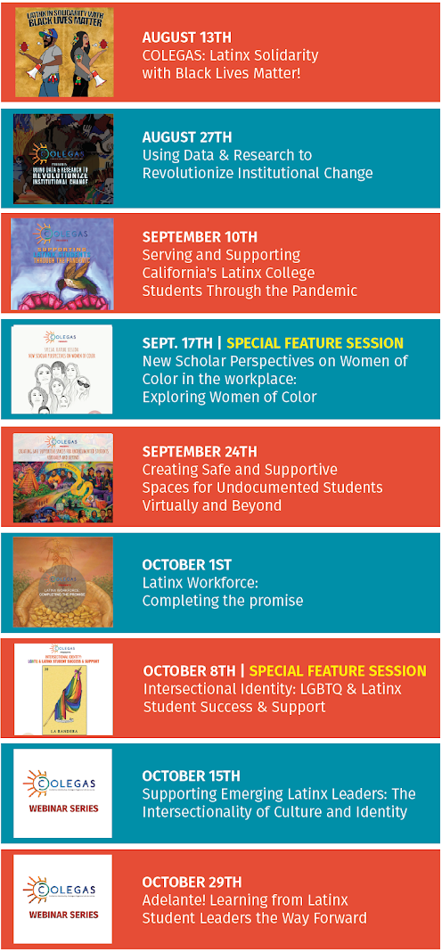
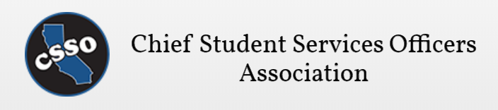









COLEGAS Latinx Student Success | Webinar Series
Thursdays 2:30 - 4 pm PST
COMPANER@S* | Latina Leadership Network Puente Project Campaign for College Opportunity Ed Trust-West Career Ladders Project Los Amigos HSI Leadership Network Dr. Jose Moreno Dr. Cecilia Rios-Aguilar Dr. Olga Rodriguez Dr. Martha Garcia Dr. Patricia Ramos
*(masculine & feminine for friends accompanying our organization)
a chapter of the National Community College Hispanic Council
Notes:
Moderator - 2min
A friendly reminder that if you already registered you do not have register again for future webinars, you will use the same link for each webinar.
Thank you to Chancellor's office, companer@s, and CLP for webinar production and coordination,

Slide 6
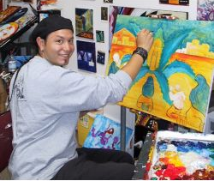

Joaquin Alejandro Newman
Artist
Connect with me:
www.forrealism.com | @forrealizm
Joaquin Alejandro Newman (Forrealism) currently lives and paints in his hometown, Oakland, CA. The son of an artist mother and a scientist father, Joaquin’s heritage of Yaqui, Mexican, and European culture has fueled his creativity. After studying fine art and digital design at Cabrillo College and UC Santa Cruz, Joaquin has worked as a painter, muralist, graphic designer, graphics engineer, and teaching artist. He currently works as an Arts Coordinator at the REACH Ashland Youth Center in San Leandro, where he teaches traditional and digital art.
Artwork: “Corazon de la Comunidad” (East View), Joaquin Alejandro Newman, Carmen Flores Community Center, Oakland, CA.
Notes:
Moderator- 30 sec
Just a quick thank you to the artist (Joaquin Newman) for giving permission to use artwork, could read one sentence from bio
http://www.forrealism.com/
https://www.facebook.com/forrealism
https://www.instagram.com/forrealizm/?hl=en
Pixs of joaquin newman and some pixs to use for the slide? https://drive.google.com/drive/folders/1K2RMnWiGNj76TUENydG2j9tZHSw5ShPx?usp=sharing

Slide 7

LATINX WORKFORCE: COMPLETING THE PROMISE
Today’s Goal(s)/ Purpose:
Highlight ideas and actions being taken to support Latinx Student success in reaching workforce goals,
Through short presentations and panel discussion unpack priority issues and challenges,
Spark ideas for further discussions and actions that can be taken at the local level to seed state impact.
Notes:
Moderator- 1 min

Slide 8
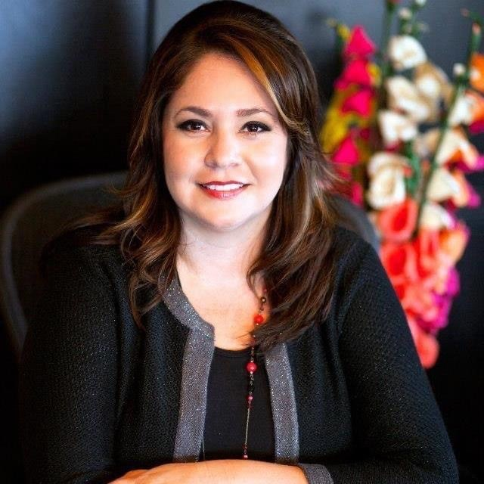
Sandra Sanchez
Assistant Vice Chancellor
Workforce & Economic Development Division
California Community College Chancellor’s Office
Notes:
Moderator - 30 seconds
Don’t need to say title nor orgs you can just say names since there is another intro before each person speaks

Slide 9

Vision Goals
Commitments
Increase credential obtainment by 20%
Increase transfer by 35% to UC and CSU
Decrease average unit obtainment for a degree to 79
Increase employment for CE students to 76% in their field of study
Reduce and erase equity gaps
Reduce regional gaps
Focus on students’ goals
Design with the students’
experience in mind
High expectations and high support
Foster use of data and evidence
Own student performance
Thoughtful innovation and action
Cross-system partnership

Slide 10
There is only one Vision for Success and it will take all of us working together to achieve it.

Slide 11
2020-21 Priorities
Guided Pathways (connect to equity, PD, integration)
Equitable Placement (evaluation, accountability, PD, integration)
Fiscal Health and Resilience (stability, PD, integration)
Financial Aid and Basic Needs (advocacy, maximize existing resources, integration)
Innovations in Education (lead exploration, remove roadblocks)

Slide 12
Equity is our Integration Framework
The Vision for Success is our foundation, our strategic mission with clear goals and commitments.
The 2020-21 Priorities and DEI Integration Plan are actions to change institutional structures.
The Call to Action responds to a moment in time and directs individuals to action that will advance the Vision for Success.
Individual Practices
(Action!)
Structural (regulations, guidance, policies)
Strategic Mission
(Goals and Commitments)

Slide 13

Advancing the Vision
  The Innovations in Education priority
  seeds changes designed to inform the transformation and evolution of the community college system;
  Shifts structures that impede reforms and perpetuate inequitable outcomes or experiences;
  Informs and supports the system-wide upskilling and professional development needed to advance the Vision for Success

Slide 14
Workforce Development Initiatives to Improve outcomes for all students
Guided pathways
Credit for Prior Learning- Plans need to be in place by Dec 2020
Competency Based Education- Second Reading Sept BOG
Supports for Work based Learning and Job placement- Need to innovate and make structural changes to support students to gain access to employment opportunities and build social capital

Slide 15
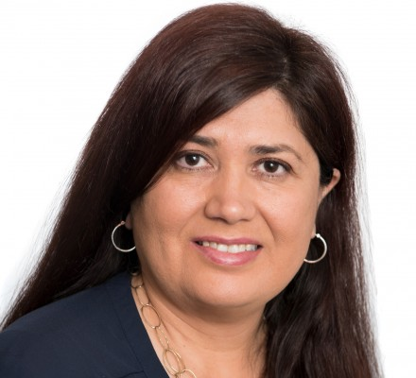
Dr. Rosa García
Director
Postsecondary Education and Workforce Development
Center for Law and Social Policy (CLASP)
Notes:
Moderator - 30 seconds
Don’t need to say title nor orgs you can just say names since there is another intro before each person speaks

Slide 16
Impact of COVID-19 on Latinx Workers and College Students
Disruptions to the postsecondary education of Latinx college students
Economic hardship on Latinx workers and families
Federal Advocacy: Need for federal relief to help Latinx students, workers and families
Notes:
Moderator- 30 sec

Slide 17
Questions?
Please add your questions in the Q&A function using the format:
Name of speaker: Your question
Example- Don Juan: Why do you think or How would approach...?
Notes:
Moderator

Slide 18
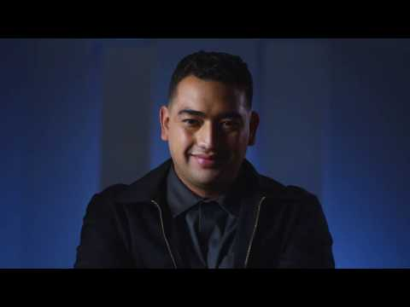
Notes:
Moderator

Slide 19
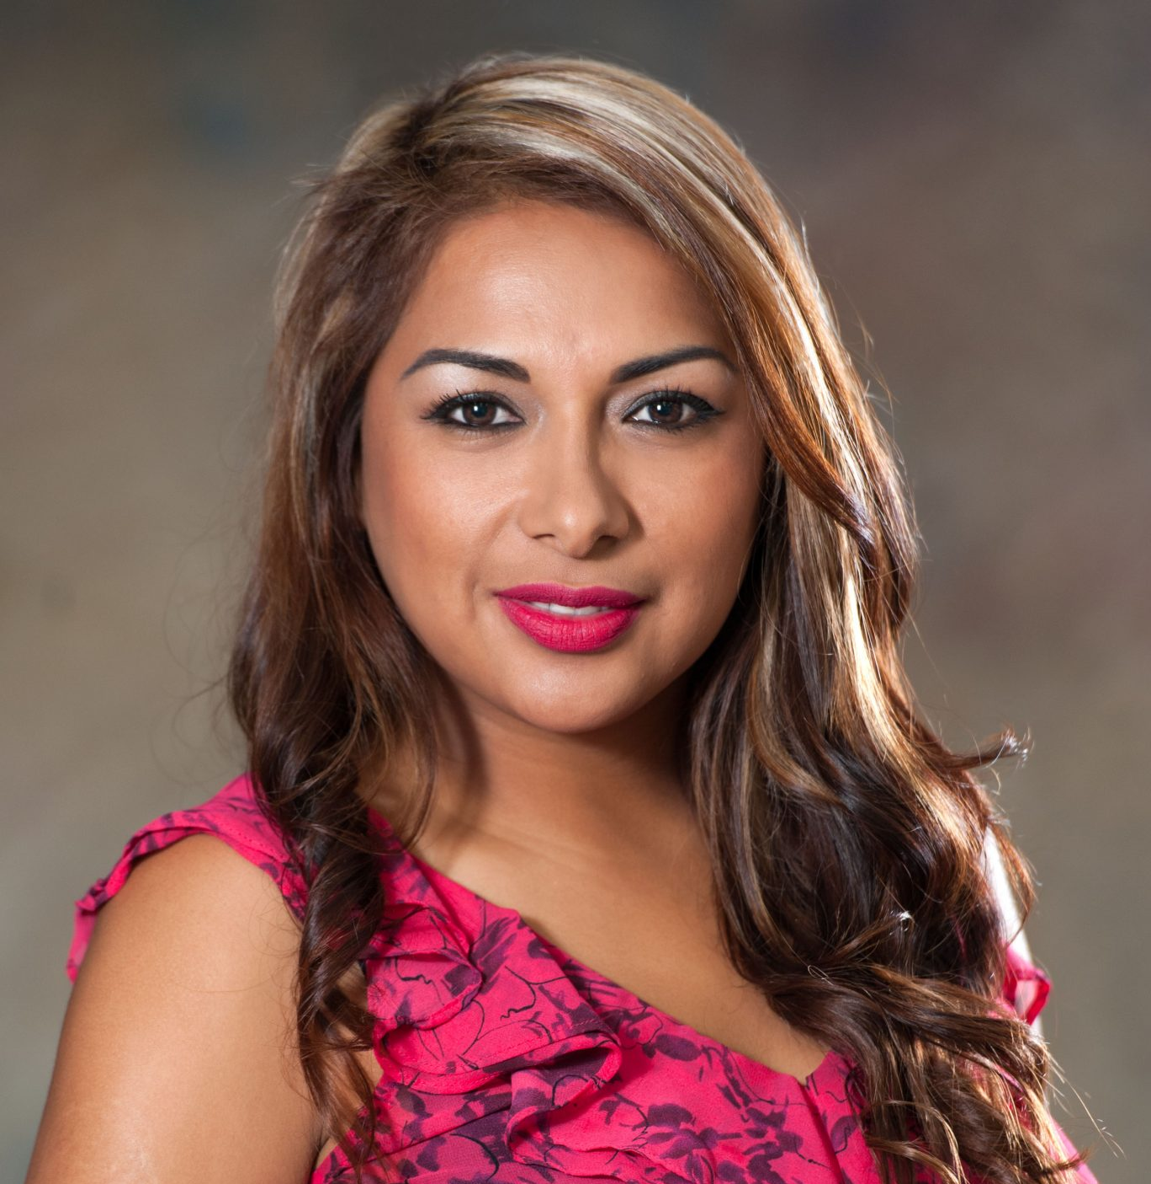
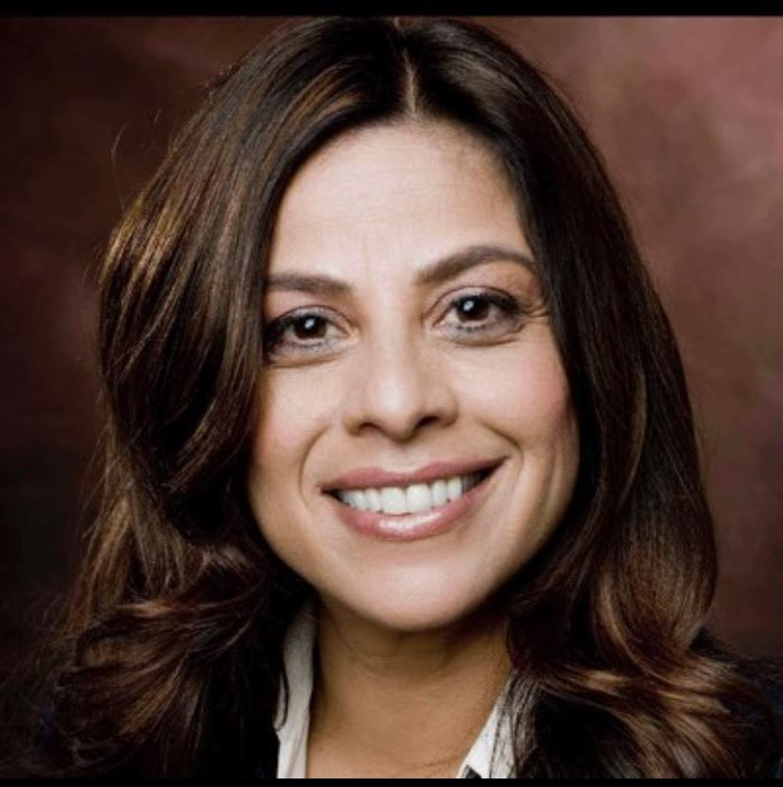
CAFECITO GUESTS
Jackie Cruz, MBA
Vice President
Advancement & Development, Hartnell College
Dr. Tricia Ramos
Dean
Workforce and Economic Development,
Santa Monica College
Dr. Rosa García
Director
Postsecondary Education and Workforce Development
Center for Law and Social Policy (CLASP)
Sandra Sanchez
Assistant Vice Chancellor
Workforce and Economic Development Division of the Chancellor’s Office
Notes:
Moderator - 30 seconds
Don’t need to say title nor orgs you can just say names since there is another intro before each person speaks

Slide 20
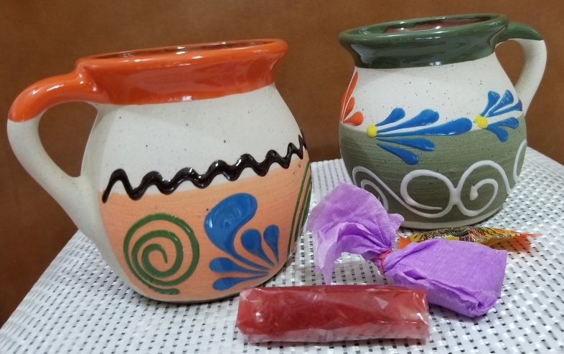
Cafecito: Una Platica con Colegas
Notes:
Moderator
Link to resources to add to chat: https://docs.google.com/document/d/15-Y3n63SL3sDkaWO6Mz-c9YXzattvPITYkUEGW39BJQ/edit

Slide 21
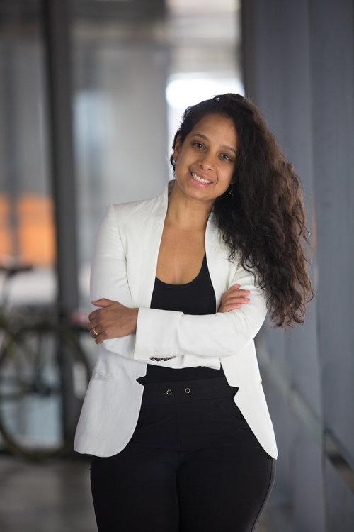
Yscaira Jimenez
CEO
Laborx
Notes:
Moderator - 30 seconds
Don’t need to say title nor orgs you can just say names since there is another intro before each person speaks

Slide 22
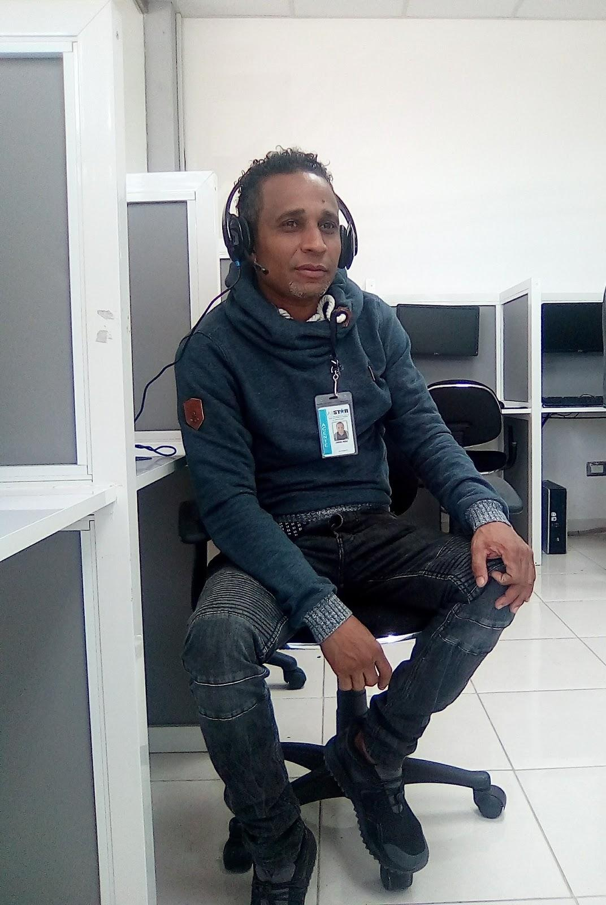

THE LINKEDIN FOR
THE LINKED OUT

Slide 23
PROBLEM: 11M Unfilled Jobs, Not Enough Graduates
11M
5M
unfilled US jobs by 2025
college graduates/year
The math
doesn’t add up

Slide 24
OPPORTUNITY: QUALIFIED UNTAPPED TALENT
40MM+ Candidates
35MM
Targeted for Workforce Innovation & Opportunity Act (WIOA) Training
7MM+
Community College Students
15K+
Boot Camp Students

Slide 25



SOLUTION: Connecting untapped talent to unfilled jobs in the U.S.
Trainers/Govt
LaborX will connect
growing companies
with TALENTED, graduates from
innovative training programs
We will close the talent gap
Companies
Jobseekers

Slide 26
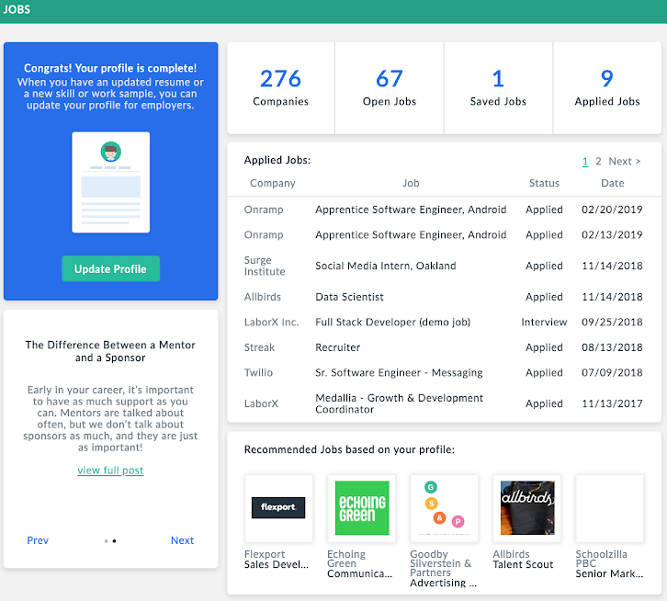
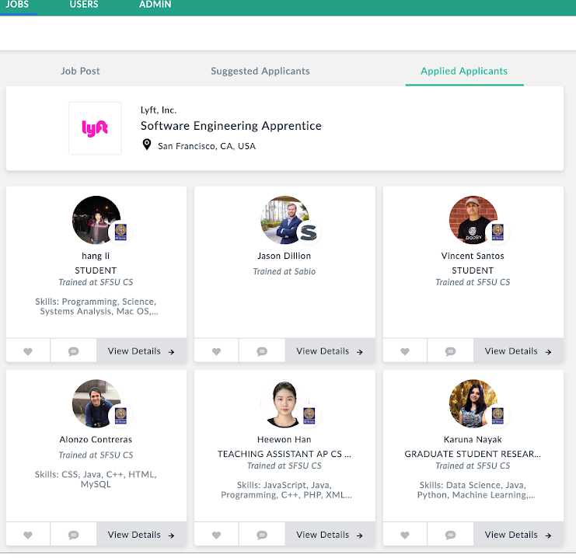

PRODUCT: Skill-based Talent Marketplace w 3d Resumes + Analytics
Jobseekers get tailored job recommendations based on their training and skills
Recruiters get tailored recommendations based on human + machine based algorithms
https://laborx.co

Slide 27





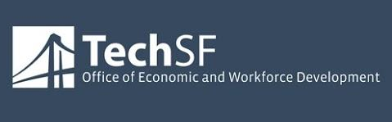






OUR PARTNERS
TRAINING PROGRAMS
EMPLOYERS

Slide 28
IMPACT PATHWAY
ACTIVITIES
Identify, vet, and aggregate talent from top training programs.
Identify, vet, and aggregate employers who offer living wage jobs that don’t require a degree
OUTPUTS
Strong digital portfolio creation
Jobs with flexible education requirements
OUTCOMES
Profile reviews
Interviews
Job offers
IMPACT
Job placement in living wage jobs
Reduced unemployment
Reduced under-employment

Slide 29
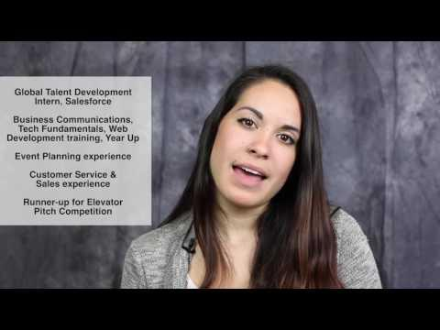
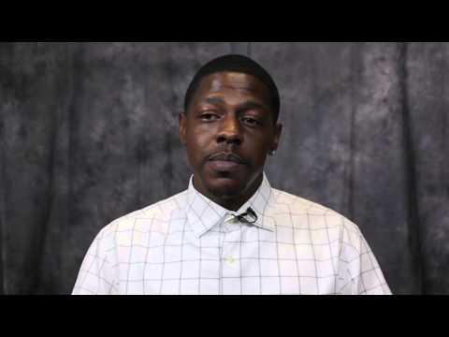
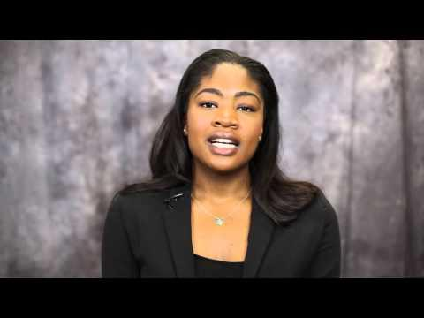
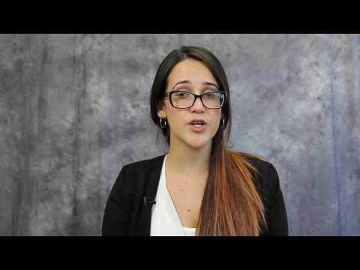
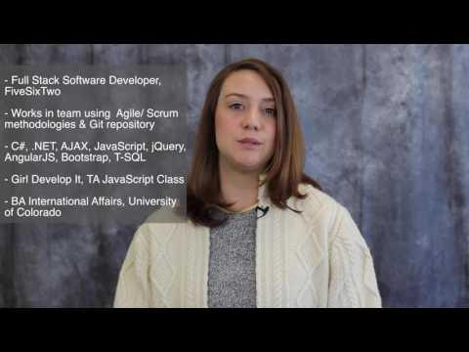
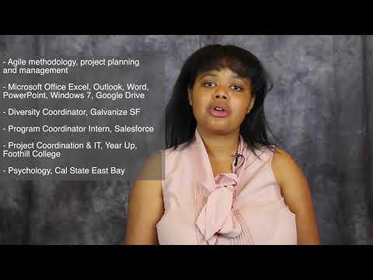
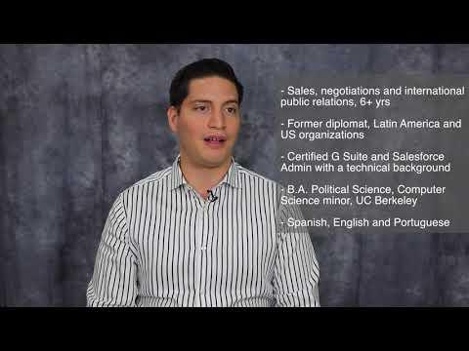
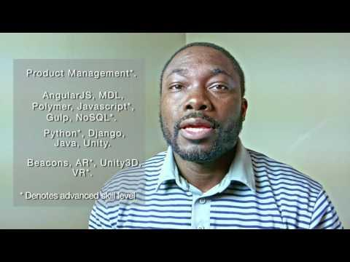
SUCCESS STORIES: Microsoft, Facebook, Honey, Boingo
Kaylee Gonzales, Year Up
Coordinator @ Farr, LLC
Michael Jamerson, Stride Ctr Helpdesk @ CC Electric Co
Sunday Ely, Oakland Pic Marketing @ Sunfolding
Gema Beltran, Sabio Engineering @ Microsoft
Lyrana Hugues, Sabio Engineering @ Microsoft
Markia Coats, Year Up Coordinator @ Galvanize
Luis Sanchez, JobTrain Coordinator @ Farr, LLC
Noble Ackerman, Udacity Product Manager @ LaborX

Slide 30

THE LINKEDIN FOR
THE LINKED OUT
contact: yscaira@laborx.co
100 per city

Slide 31
Questions for the Cafecito Panel and featured speaker?
Please add your questions in the Q&A function using the format:
Name of speaker: Your question
Example- Dr. Garcia: Why do you think...
or Can you share an example of...?
Notes:
Moderator-
Asks speaker 3, one or two questions
Moves on to larger Q&A with all three speakers

Slide 32
Summary Action Takeaways:
How do we develop a culture centered on student post college outcomes ?
Asking questions of you colleagues!
Thinking different, acting different, faster better!
Notes:
Moderator/speakers fill in before end of session!

Slide 33
WHERE DO I ACCESS THIS RECORDING?
California Community Colleges faculty, staff, and administrators will find resources and information within the Vision Resource Center, including the recording of this webinar. Log in at visionresourcecenter.cccco.edu/login.
After logging in, under the “Communities” menu, visit “All Communities” and look for “CCC | Webinars, Conferences, and Events.” Select the community and then click “Join Community” to access the content within the “COLEGAS Latinx Student Success Webinar Series” topic.

Slide 34
Career Ladders Project promotes equity-minded community college redesign. CLP collaborates with community colleges and their partners to build capacity for equity-minded redesign. We research, demonstrate, and elevate promising practices. And, based on our work, we offer policy recommendations to help advance student-centered reform.
MISSION
Notes:
Moderator- 30 seconds
Note: A quick thank you to CLP for providing webinar series coordination support. We hope you have been enjoying the series as we are approaching the end we’ll be asking you for your feedback. As an potential connection to this session CLP invites you to the November 13th and 20 – 9:30 am to 12:00 noon Guided Pathways Workshop Webinars
Join us to take a deeper look at how colleges are creating pathways to college and career success with a focus on equity and economic recovery.
CLP is producing these workshops with funding from the CCCCO.

Slide 35

Upcoming Events
Free conference and students scholarships will be provided
Guided Pathways Workshop Webinars
November 13th and 20th
9:30 am to 12:00 noon
Join us to take a deeper look at how colleges are creating pathways to college and career success with a focus on equity and economic recovery.
CLP is producing these workshops with funding from the CCCCO.
Notes:
Moderator - 30 seconds
Link for conference https://drive.google.com/file/d/1e050gOUYBGj3-9KX9laRLoF-Lzgps-a5/view?usp=sharing

Slide 36





THANK YOU for joining us!
We hope to see you next time:
Intersectional Identity:
LGBTQ & Latinx Student Success & Support
OCT 8th from 2:30 pm to 4pm
@cccolegas
cccolegas.org
connect@cccolegas.org
Notes:
Luis - 1min

